Slide 1


Lecture 27
Produced by Dr. Worldwide
Welcome to the 305
~
~

Slide 2


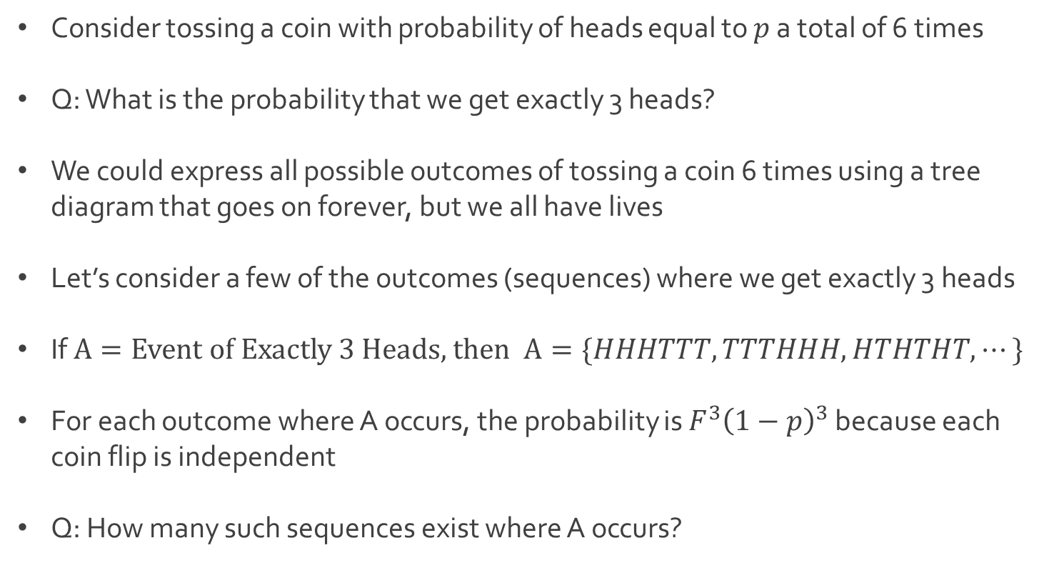
Binomial Probability
Consider tossing a coin with probability of heads equal to $p$ a total of 6 times
Q: What is the probability that we get exactly 3 heads?
We could express all possible outcomes of tossing a coin 6 times using a tree diagram that goes on forever, but we all have lives
Let’s consider a few of the outcomes (sequences) where we get exactly 3 heads
If $A=Event of Exactly 3 Heads$, then $A=\{HHHTTT,TTTHHH,HTHTHT, ⋯\}$
For each outcome where A occurs, the probability is $F^{3}{\left(1−p\right)}^{3}$ because each coin flip is independent
Q: How many such sequences exist where A occurs?

Slide 3
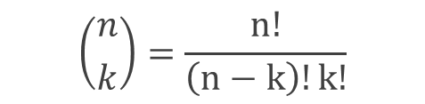
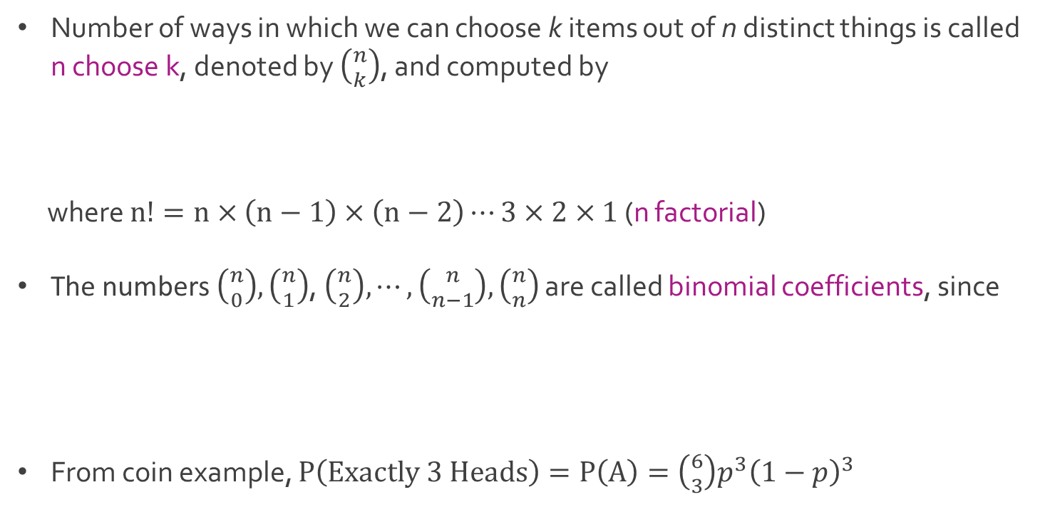

Binomial Probability
Number of ways in which we can choose k items out of n distinct things is called n choose k, denoted by $\left({n \atop k}\right)$, and computed by
where $n!=n×\left(n−1\right)×\left(n−2\right)⋯3×2×1$ (n factorial)
The numbers $\left({n \atop 0}\right),\left({n \atop 1}\right)$, $\left({n \atop 2}\right),⋯,\left({n \atop n−1}\right),\left({n \atop n}\right)$ are called binomial coefficients, since
From coin example, $P\left(Exactly 3 Heads\right)=P\left(A\right)=\left({6 \atop 3}\right)p^{3}{\left(1−p\right)}^{3}$
$$\left({n \atop k}\right)=\frac{n!}{\left(n−k\right)!k!}$$
$${\left(a+b\right)}^{n}=\sum_{k=0}^{n}{\left({n \atop k}\right)a^{k}b^{n−k}}$$

Slide 4

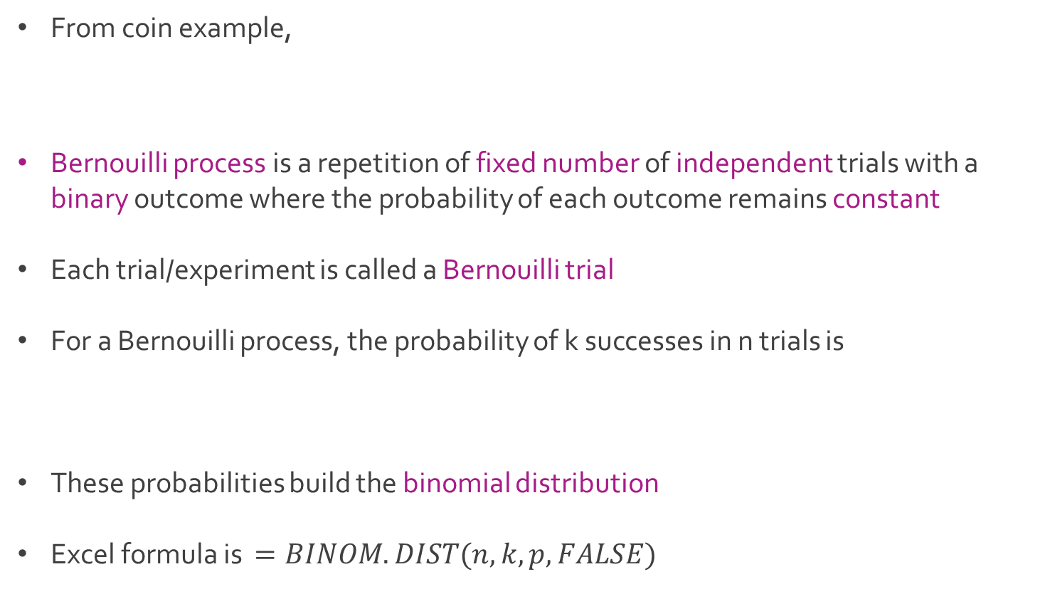
Binomial Probability
From coin example,
Bernouilli process is a repetition of fixed number of independent trials with a binary outcome where the probability of each outcome remains constant
Each trial/experiment is called a Bernouilli trial
For a Bernouilli process, the probability of k successes in n trials is
These probabilities build the binomial distribution
Excel formula is $=BINOM.DIST(n,k,p,FALSE)$
$$P\left(Exactly 3 Heads\right)=P\left(A\right)=\left({6 \atop 3}\right)p^{3}{\left(1−p\right)}^{3}$$
$$\left({n \atop k}\right)p^{n}{\left(1−p\right)}^{n−k}$$

Slide 5
Binomial Probability
From coin example,
Bernouilli process is a repetition of fixed number of independent trials with a binary outcome where the probability of each outcome remains constant
Each trial/experiment is called a Bernouilli trial
For a Bernouilli process, the probability of k successes in n trials is
These probabilities build the binomial distribution
Excel formula is $=BINOM.DIST(n,k,p,FALSE)$
$$P\left(Exactly 3 Heads\right)=P\left(A\right)=\left({6 \atop 3}\right)p^{3}{\left(1−p\right)}^{3}$$
$$\left({n \atop k}\right)p^{n}{\left(1−p\right)}^{n−k}$$

Slide 6
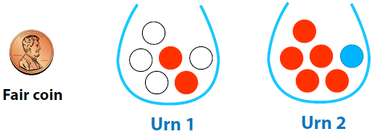

Ex: Balls and Urns
Suppose we have a fair coin and two urns with six balls each
Urn 1 has 4 white balls and 2 red balls
Urn 2 has 5 red balls and 1 blue ball
Experiment
Flip a fair coin
If heads, draw a ball from urn 1
If tails, draw a ball from urn 2
Q: What are the possible colors of the ball we draw?

Slide 7
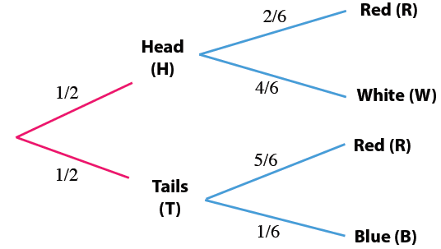

Ex: Balls and Urns
Probability tree to describe all possible outcomes
List of all outcomes
Flip heads and grab red ball ($H∩R)$
Flip heads and grab white ball ($H∩W$)
Flip tails and grab red ball ($T∩R$)
Flip tails and grab blue ball ($T∩B$)

Slide 8
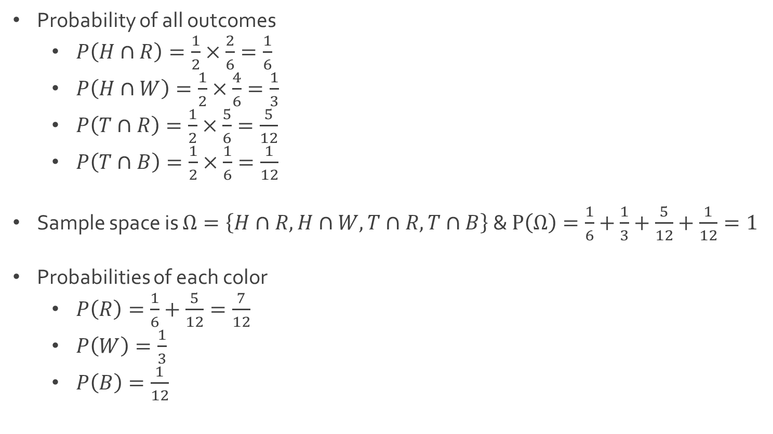
Ex: Balls and Urns
Probability of all outcomes
$P\left(H∩R\right)=\frac{1}{2}×\frac{2}{6}=\frac{1}{6}$
$P\left(H∩W\right)=\frac{1}{2}×\frac{4}{6}=\frac{1}{3}$
$P\left(T∩R\right)=\frac{1}{2}×\frac{5}{6}=\frac{5}{12}$
$P\left(T∩B\right)=\frac{1}{2}×\frac{1}{6}=\frac{1}{12}$
Sample space is $Ω=\left\{H∩R,H∩W,T∩R,T∩B\right\}$ & $P\left(Ω\right)=\frac{1}{6}+\frac{1}{3}+\frac{5}{12}+\frac{1}{12}=1$
Probabilities of each color
$P\left(R\right)=\frac{1}{6}+\frac{5}{12}=\frac{7}{12}$
$P\left(W\right)=\frac{1}{3}$
$P\left(B\right)=\frac{1}{12}$

Slide 9


Ex: Balls and Urns
Recall the probability tree
Q: What is probability of a white ball given we flip heads?
Q: Given we have a white ball, what is the probability the coin flip was heads?
$$P\left(W | H\right)=??$$
$$P\left(H | W\right)=??$$

Slide 10


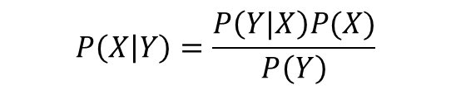


Bayesian Analysis
Recall the formula for conditional probability
Based off this formula,
With simple substitution,
Since there are two events, $P\left(Y\right)=P(Y∩X)+P(Y∩X^{c})$
This last fact comes from the two branches of a probability tree
$$P\left(X | Y\right)=\frac{P\left(X∩Y\right)}{P\left(Y\right)}$$
$$P\left(Y | X\right)=\frac{P\left(X∩Y\right)}{P\left(X\right)}$$
$$P\left(Y | X\right)P(X)=P(X∩Y)$$
$$P\left(X | Y\right)=\frac{P\left(Y|X\right)P(X)}{P\left(Y\right)}$$

Slide 11
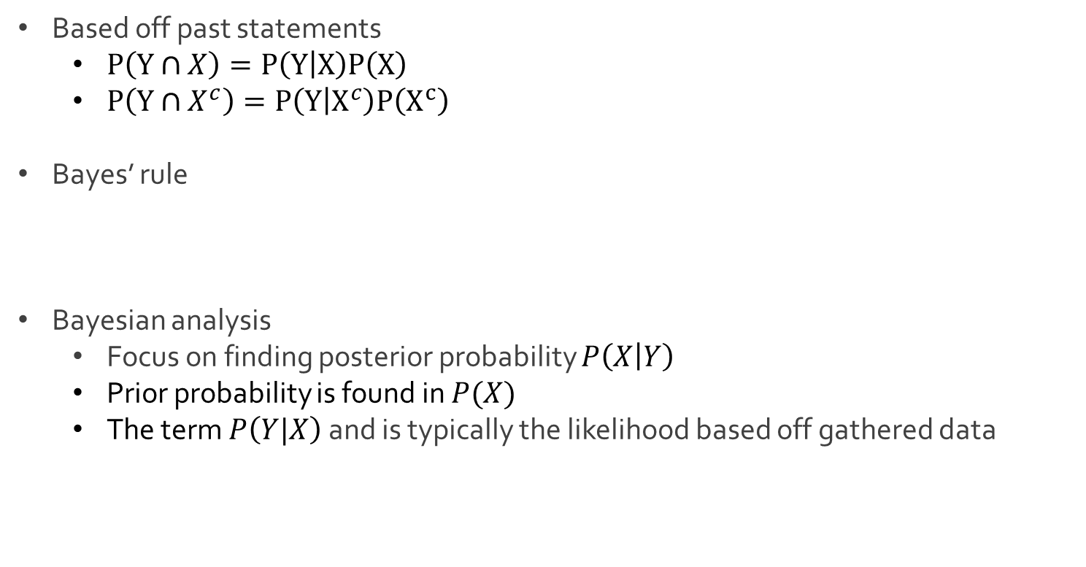
Bayesian Analysis
Based off past statements
$P\left(Y∩X\right)=P\left(Y | X\right)P\left(X\right)$
$P\left(Y∩X^{c}\right)=P\left(Y | X^{c}\right)P\left(X^{c}\right)$
Bayes’ rule
Bayesian analysis
Focus on finding posterior probability $P\left(X | Y\right)$
Prior probability is found in $P(X)$
The term $P\left(Y|X\right)$ and is typically the likelihood based off gathered data
$$P\left(X | Y\right)=\frac{P\left(Y|X\right)P(X)}{P(Y)}=\frac{P\left(Y|X\right)P(X)}{P\left(Y | X\right)P\left(X\right)+P\left(Y | X^{c}\right)P\left(X^{c}\right)}$$

Slide 12
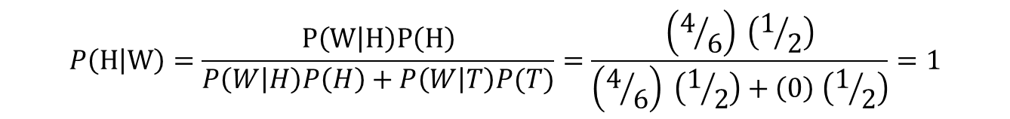
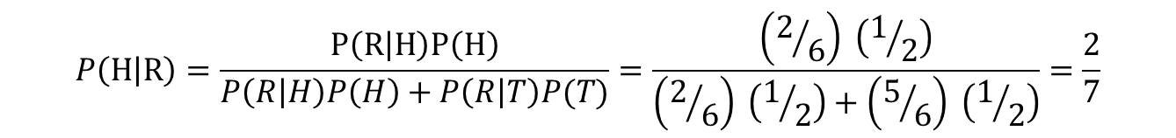
Ex: Balls and Urns
Back to the probability tree
Q: Given we have a white ball, what is the probability the coin flip was heads?
Q: Given we have a red ball, what is the probability the coin flip was heads?
$$P\left(H | W\right)=\frac{P\left(W | H\right)P\left(H\right)}{P\left(W | H\right)P\left(H\right)+P\left(W | T\right)P(T)}=\frac{\left(4/6\right) \left(1/2\right)}{\left(4/6\right) \left(1/2\right)+\left(0\right) \left(1/2\right)}=1$$
$$P\left(H | R\right)=\frac{P\left(R | H\right)P\left(H\right)}{P\left(R | H\right)P\left(H\right)+P\left(R | T\right)P(T)}=\frac{\left(2/6\right) \left(1/2\right)}{\left(2/6\right) \left(1/2\right)+\left(5/6\right) \left(1/2\right)}=\frac{2}{7}$$

Slide 13

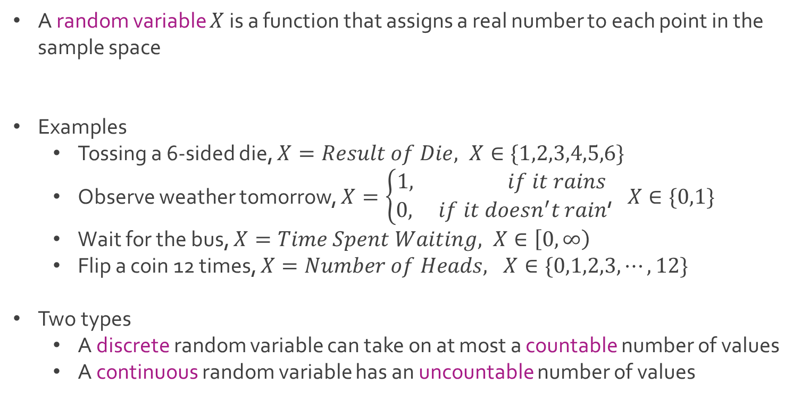
Random Variables
A random variable $X$ is a function that assigns a real number to each point in the sample space
Examples
Tossing a 6-sided die, $X=Result of Die, X∈\{1,2,3,4,5,6\}$
Observe weather tomorrow, $X=\left\{\begin{aligned}1, if it rains \\ 0, if it doesn^{′}t rain\end{aligned}\right.$, $X∈\{0,1\}$
Wait for the bus, $X=Time Spent Waiting, X∈\left[0,∞\right)$
Flip a coin 12 times, $X=Number of Heads, X∈\{0,1,2,3, ⋯, 12\}$
Two types
A discrete random variable can take on at most a countable number of values
A continuous random variable has an uncountable number of values
$$X(s):S→ℝ$$

Slide 14
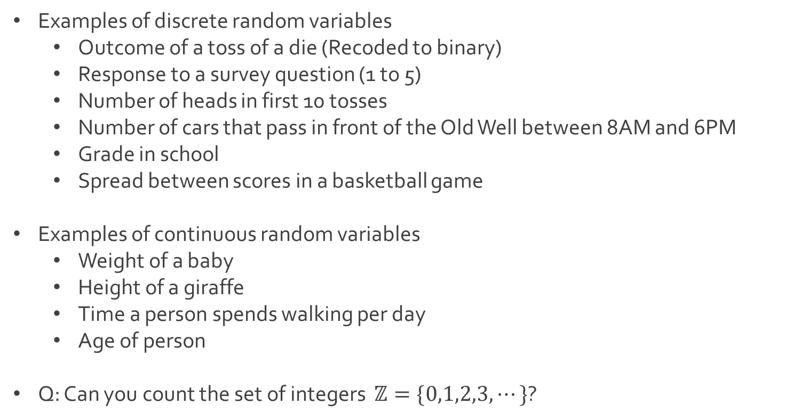
Random Variables
Examples of discrete random variables
Outcome of a toss of a die (Recoded to binary)
Response to a survey question (1 to 5)
Number of heads in first 10 tosses
Number of cars that pass in front of the Old Well between 8AM and 6PM
Grade in school
Spread between scores in a basketball game
Examples of continuous random variables
Weight of a baby
Height of a giraffe
Time a person spends walking per day
Age of person
Q: Can you count the set of integers $ℤ=\{0,1,2,3,⋯\}$?

Slide 15

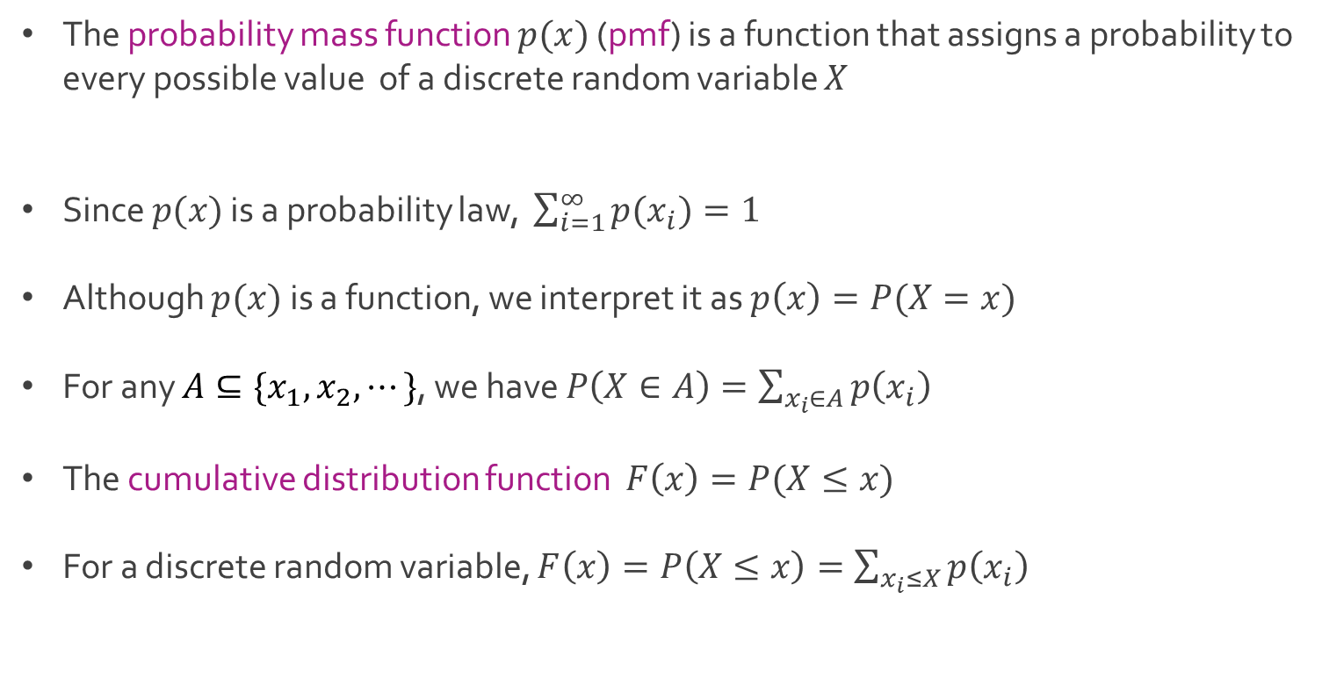
Discrete Random Variable
The probability mass function $p(x)$ (pmf) is a function that assigns a probability to every possible value of a discrete random variable $X$
Since $p(x)$ is a probability law, $\sum_{i=1}^{∞}{{p(x}_{i})=1}$
Although $p(x)$ is a function, we interpret it as $p\left(x\right)=P(X=x)$
For any $A⊆\{x_{1},x_{2},⋯\}$, we have $P\left(X∈A\right)=\sum_{x_{i}∈A}{p\left(x_{i}\right)}$
The cumulative distribution function $F\left(x\right)=P(X≤x)$
For a discrete random variable, $F\left(x\right)=P\left(X≤x\right)=\sum_{x_{i}≤X}{p\left(x_{i}\right)}$
$$p\left(x\right):\{x_{1},x_{2},⋯\}→[0,1]$$

Slide 16

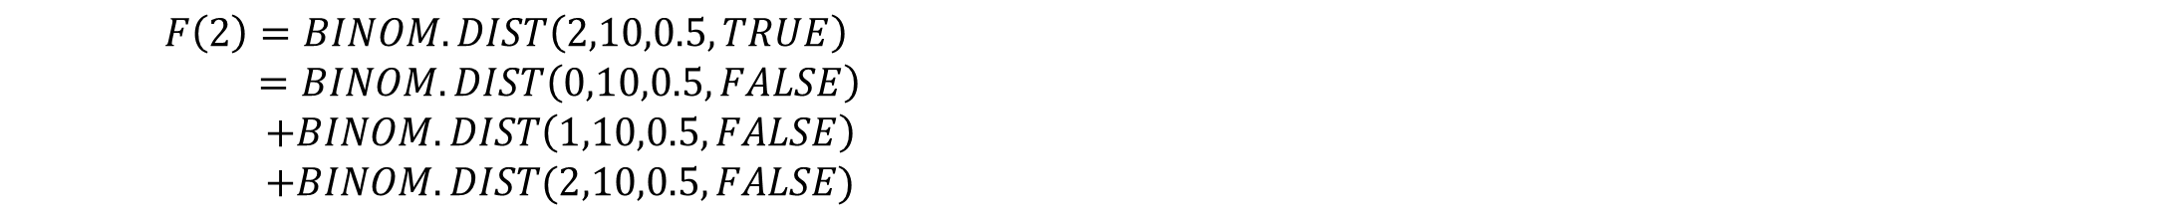
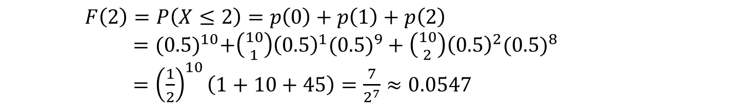
Ex: Tossing Coin
We toss a fair coin 10 times
Q: What is the probability there will be at most 2 heads?
The random variable $X=number of heads$
The variable $X$ is a binomial random variable
We want to compute $F\left(2\right)=P(X≤2)$
In Excel,
$p\left(x\right)=\left({10 \atop x}\right){(0.5)}^{x}({0.5)}^{10−x}$ where $x∈\{0,1,2,⋯,10\}$
$F\left(2\right)=P\left(X≤2\right)=p\left(0\right)+p\left(1\right)+p\left(2\right)$
$={(0.5)}^{10}+\left({10 \atop 1}\right){\left(0.5\right)}^{1}({0.5)}^{9}+\left({10 \atop 2}\right){\left(0.5\right)}^{2}({0.5)}^{8}$
$={\left(\frac{1}{2}\right)}^{10}\left(1+10+45\right)=\frac{7}{2^{7}}≈0.0547$
$F\left(2\right)=BINOM.DIST\left(2,10,0.5,TRUE\right)$
$=BINOM.DIST\left(0,10,0.5,FALSE\right)$
$+BINOM.DIST\left(1,10,0.5,FALSE\right)$
$+BINOM.DIST(2,10,0.5,FALSE)$

Slide 17
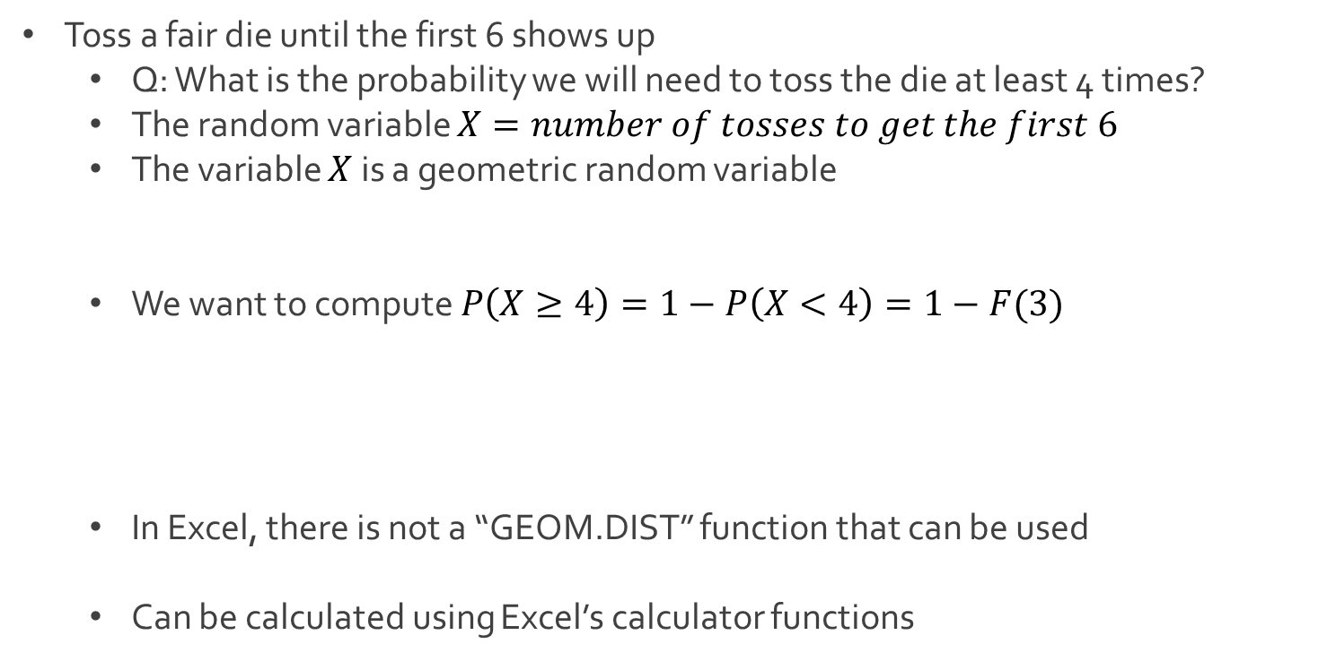
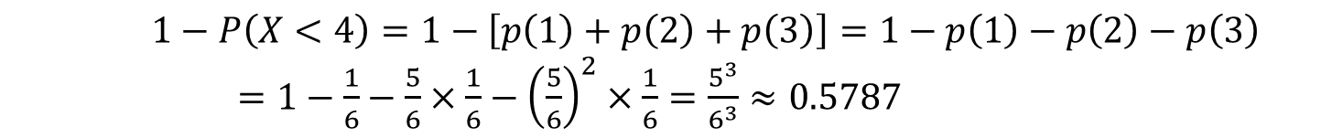
Ex: Rolling Die
Toss a fair die until the first 6 shows up
Q: What is the probability we will need to toss the die at least 4 times?
The random variable $X=number of tosses to get the first 6$
The variable $X$ is a geometric random variable
We want to compute $P\left(X≥4\right)=1−P\left(X<4\right)=1−F(3)$
In Excel, there is not a “GEOM.DIST” function that can be used
Can be calculated using Excel’s calculator functions
$p\left(x\right)={\left(\frac{5}{6}\right)}^{x−1}\left(\frac{1}{6}\right)$ where $x∈\{1,2,3,⋯\}$
$1−P\left(X<4\right)=1−\left[p\left(1\right)+p\left(2\right)+p\left(3\right)\right]=1−p\left(1\right)−p\left(2\right)−p\left(3\right)$
$=1−\frac{1}{6}−\frac{5}{6}×\frac{1}{6}−$ ${\left(\frac{5}{6}\right)}^{2}×\frac{1}{6}=\frac{5^{3}}{6^{3}}≈0.5787$

Slide 18




The End
Dale

